Slide 1

Keep Your Sleep!
An Intro to Database Continuous Integration
and Continuous Delivery.
Nathan Low
Twitter: @Octacon100
Website: https://octacon100.github.io/
Notes:
G’Day there! I’m Nathan Low, and this talk is called “Keep Your Sleep”. Thanks for taking the time to watch this talk. I’m going to be covering database Continuous Integration and Delivery, and by the time you’ve seen these slides and gone through the code that I’ll be sharing with you, you will be able to make your database releases bulletproof and extremely useful.

Slide 2

Introduction
“The journey of a thousand miles begins with a single step.” – Lao-Tzu.
Notes:
But first, some introductions…

Slide 3
Agenda
Different types of database migration.
Creating an Azure DevOps Build Pipeline that:
1. Runs Flyway to run migration scripts on a database in Azure.
2. Uses tSQLt to run unit tests, and report on those tests.
3. Runs SchemaSpy to generate database documentation.
The software that this process uses.
Notes:
Today’s agenda covers:
Database migration types
Making a process that:
Runs Flyway to run migration scripts so you know your release will work on release night
Uses TSqlT to run unit tests, and report on those tests so you know your database is working correctly
Runs SchemaSpy to generate database documentation so your team mates know exactly how the database should be working
And the software mentioned

Slide 4

About me
An Aussie in Boston.
Worked with databases for over 10 years.
Worked on CI/CD with databases at multiple companies.
Twitter: @Octacon100
Github: http://github.com/Octacon100
Website: https://octacon100.github.io/
Notes:
And here’s me. I’ve been working on databases for most of my career, and I’m usually the one pushing for GIT and pull requests as well. I’ve got a git hub with some useful code, a blog that I’ll be updating with things I found out during the creation of this presentation, and you can reach me on twitter after this if you have any questions.

Slide 5
Notes
All questions will be answered at the end.
All code will be made available on GitHub.
Notes:
As slidies say

Slide 6
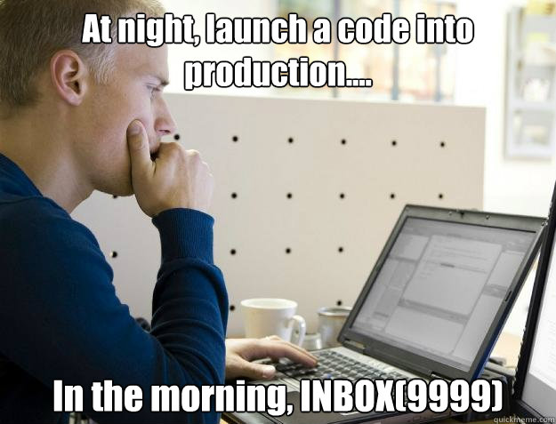
Releases can be painful!
Ever have a release go wrong?
I know I have.
CI/CD to the rescue!
Notes:
Ever have a release go so badly you have to roll everything back? Spending hours in the early hours of the morning trying to figure out what was broken and how to fix it?
Over the years of my career in software development and releasing databases, SSIS packages, and code to various servers, I certainly have.

Slide 7
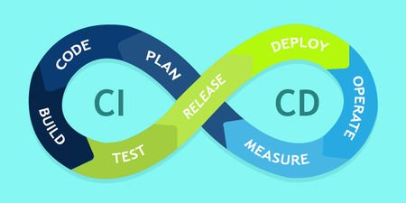
What is CI/CD?
Continuous Integration (CI)
Integrating code into share repository (Git, etc) and verifying changes with a build.
Continuous Delivery (CD)
Releasing changes to production by ensuring that code is always in a deployable state.
Notes:
Add notes from
https://stackify.com/what-is-cicd-whats-important-and-how-to-get-it-right/
As things to talk about here.
Usually CD will deploy from Master/Main, with frequent small deployments.

Slide 8
Database releases
“Please don’t let this click ruin my day” – some DBA doing a release, somewhere, someday.

Slide 9

How does this apply to databases?
Releasing databases is different to releasing code.
You must be more careful, as it’s more of a migration than an update, due to persistent data.
You don’t want to accidentally be deleting rows in a table on production.
Notes:
Releasing databases is different to releasing code, usually with code you compile your code into objects that can be deployed, called artifacts, but with databases, most of the time the code you are writing is the artifact to be deployed, and the object you are working on isn’t something that could be rolled back easily.
With the steps I

Slide 10
How does this apply to databases?
CI/CD can include many things, for example:
Database builds and deployments.
Unit testing and reporting.
Automated documentation.
Notes:
CI/CD can include many things, and in this talk I will be focusing on the following topics – Database Builds and Deployments using Flyway, Unit testing and reporting on unit tests using TSqlT, and automated generation of documentation using Flyway:

Slide 11
Two database deployment approaches
State-Based:
You describe how you want the database to look, the tool will create the code to get the database to match the state you want.
Migration-Based:
You create database change scripts, and the tool will run them in the order you supply.

Slide 12
Two database deployment approaches: Tools
State-Based:
Sql Server Data Tools.
Redgate SQL Source Control.
Apex SQL Source Control.
Many more…
Migration-Based:
Flyway.
Liquibase.
Sqitch.
Redgate ReadyRoll.
Many more…

Slide 13
Two database deployment approaches: Pros
State-Based:
No migration scripts needed.
Helpful tools for checking code in and ensuring that database is buildable.
Migration-Based:
You control what code is going to be run and know exactly what will be run.
You learn how to write repeatable database code.
Notes:
Can probably make these punchier and put the notes in here
State-Based
Pros
Don’t need to write any migration scripts
Nice tools for checking code in and ensuring that database is buildable
Migration-Based
Pros
You will know exactly what code is going to be run and have more control
You learn how to write repeatable database code.

Slide 14
Two database deployment approaches: Cons
State-Based:
Slow or broken migration scripts sometimes generated.
You might change parts of the database you do not want to.
Migration-Based:
Extra coding needed for repeatable code.
More onus on developer to ensure that code will work.
Notes:
Can probably make these punchier and put the notes in here
State-Based
Cons
In my experience, the migration scripts generated are slow and sometimes broken, which is tricky to deal with during a release.
You might change parts of the database you do not want to
Migration-Based
Cons
Extra coding is needed to make the code repeatable
More onus on developer to ensure that your code will work and all objects work together

Slide 15
Database CI/CD tools
“Everything we release with Tool is inspired by our music.” – Maynard James Keenan.

Slide 16
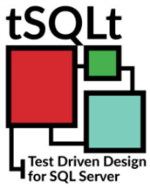

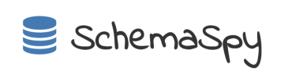
CI/CD tools
My build process uses the following tools:
Flyway.
tSQLt.
SchemaSpy.

Slide 17

Enter Flyway
Flyway is a simple migration-based deployment tool.
Free for the community version.
Write and run simple SQL.
No building.
History table tracks deployed scripts and checksums.
Will run necessary scripts automatically.
Notes:
Flyway is a command line tool that makes migration scripting easy
Just write the SQL you want to run, and it runs. No building.
It stores the scripts that have been run in a history table, so it doesn’t rerun SQL scripts
It can also rerun repeatable scripts, using checksums to see which scripts have changed, and rerun scripts that have changed

Slide 18
Database Unit Testing
Are you sure your procedures work?
Set up your data, run your procedure, assert your test works, and rollback the whole transaction.
Example Tools:
Sql Server Data Tools.
tSQLt.
Redgate SQLTest. (Uses tSQLt.)
Notes:
Are you sure your procedures work?
Tools:
Sql Server Data Tools
TSqlT
Redgate SQLTest (Uses TSqlT)
Set up your data, run your sproc, assert your test works, and rollback the whole transaction

Slide 19

Enter tSQLt
Enables you to write unit tests in MS SQL Server.
Enables you to create fake tables to load with data, ignoring constraints, foreign keys, etc.
Notes:
Come back to add more to this slide
Enables you to write unit tests in MS SQL Server
Enables you to create fake tables to load with data, ignoring constraints, foreign keys, etc

Slide 20
Database Documentation Generation
How often is documentation put off because something else needs to be done?
What about documentation that is stale and will never be updated?
Wouldn’t it be great if a living document was generated each time a database was built?

Slide 21
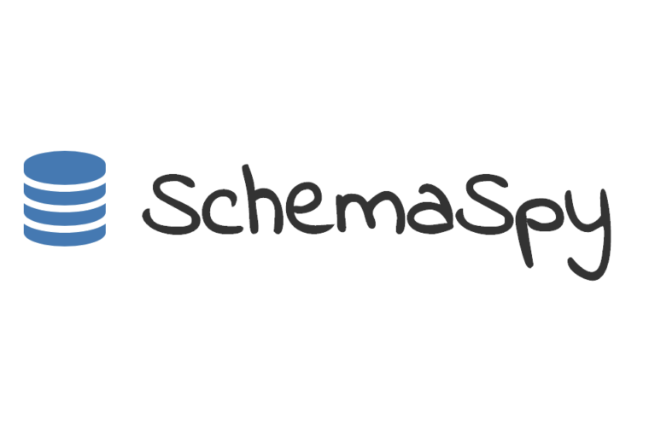
Enter SchemaSpy
An open-source, java program that generates HTML5 documentation for all your tables and their relationships with diagrams.
Also finds anomalies in your database. (Needed Foreign Keys, etc.)
Notes:
Come back to add more to this slide
Enables you to write unit tests in MS SQL Server
Enables you to create fake tables to load with data, ignoring constraints, foreign keys, etc

Slide 22
CI/CD tools
Now we know which tools we can use for which CI/CD steps.
Database builds and deployments:
Flyway.
Unit testing and reporting:
tSQLt.
Automated documentation:
SchemaSpy.

Slide 23
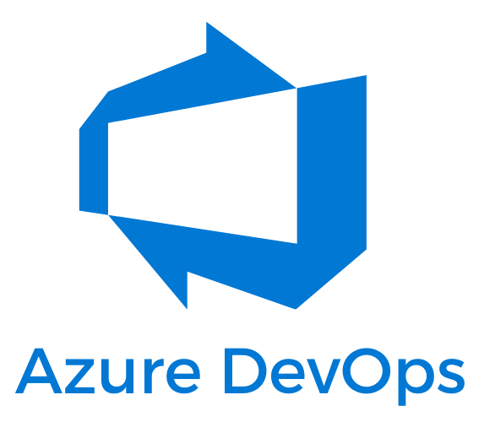
How is this all going to be run?
Azure DevOps!
Uses YAML.
Works with GIT repositories.
Enables use of Docker containers to use external tools.
Runs PowerShell scripts and most DevOps tools.
Notes:
How are all these different tools going to be run on an Azure database?
Azure DevOps is a great tool for working on Azure databases.
Uses YAML and I’ll show you some examples of that, works with GIT repositories, runs PowerShell scripts.

Slide 24
So, you’ve told me all about these fancy tools, what now fancy man?
I like to begin with the end in mind.
It’s demo time!
Notes:
I like to begin with the end in mind, so I’ll show you what you end up with, why it’s cool, and then the steps you’ll want to follow to get your database in that state.
(Demo)

Slide 25
Back to work!
Let’s get your databases into that state.
Please write out any questions you have during this and I’ll try to cover them in more detail in the next demo I’ll have at the end.
Notes:
Now you’ve seen what is possible, I want you give you the power to get to that state too. You might have an existing database in Azure, but I’m going to assume you’re going to be starting from nothing so there’s probably going to be some steps you might have already done that I’m going to mention for others. Please bear that in mind.

Slide 26
First things first - Azure
You’ll need an Azure account or ability to set up databases in Azure.
You can create free databases when you start.
My example database is $5 a month. (Basic 1GB/S0.)
The concepts here focus on Azure builds.
I’ve used Flyway, PowerShell and Docker for local builds.
Notes:
You’ll need an Azure account or ability to set up databases in Azure
This talk is mostly set up for a database on Azure
The concepts here translate well to on premise databases, but you’ll need to set up your own release script
I’ve had a lot of luck using Docker for local builds

Slide 27
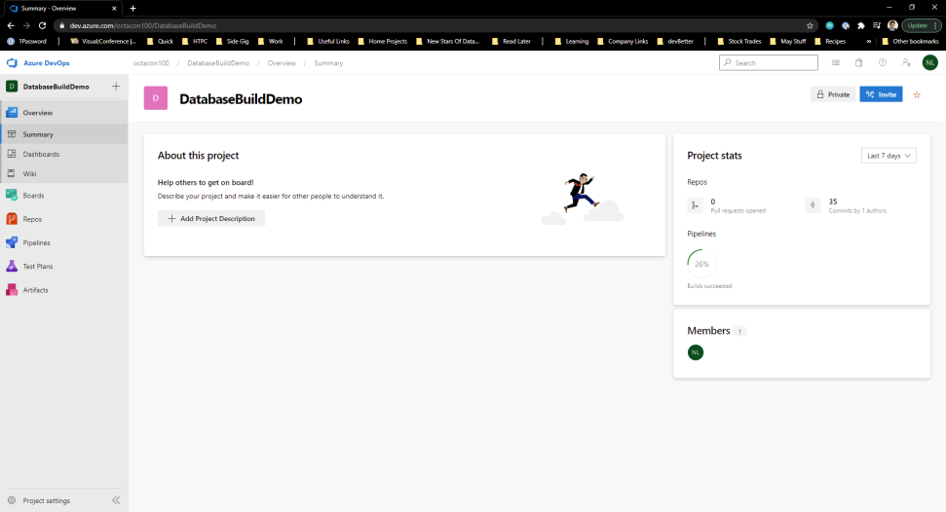
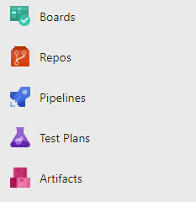
First things first – Azure DevOps
Create a project in Azure DevOps and set up payment for at least one Microsoft hosted pipe.
Areas of interest:
Repos – Where your code lives.
Pipelines – Where your builds and releases live.
Notes:
Create a project in Azure DevOps
Areas you’ll mostly be interested for this project are:
Repos – Where your code lives
Pipelines – Where your builds live
Releases – Where your releases to your environments live

Slide 28
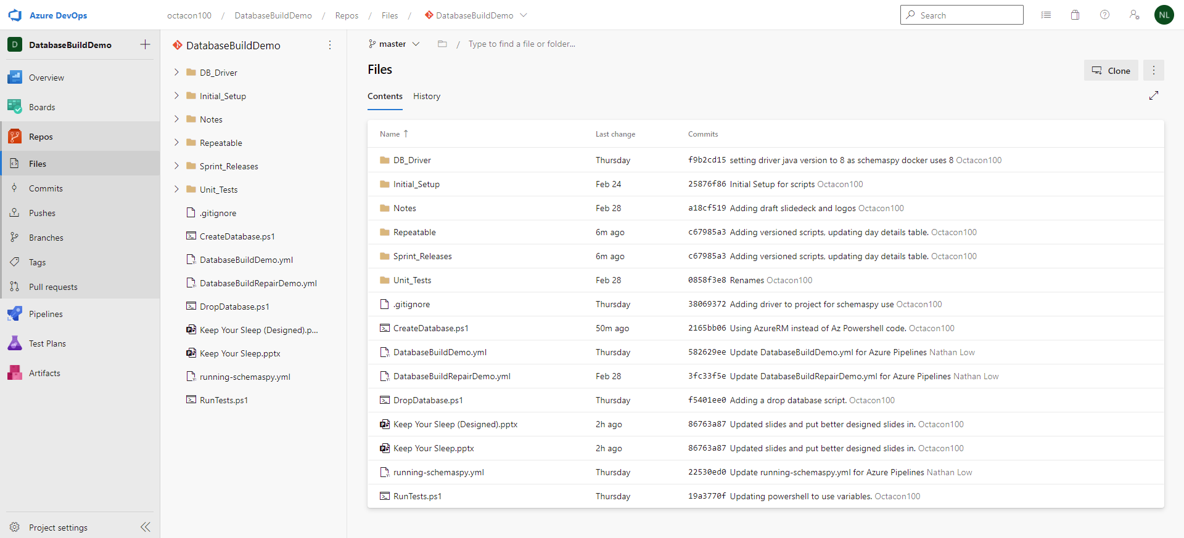
Check your repo
Make sure you have code in your repository.
I prefer using GIT repositories for pull requests and simpler branching.
Notes:
Need to replace this will an image that includes a release_script

Slide 29
1st stop - Flyway setup
We’ll review:
Folder structure for Flyway.
How Flyway works.
Idempotent scripting.
Getting Flyway running on Azure DevOps with Docker and YAML.

Slide 30
Code sections
For Flyway Code, I like to separate the code into different sections:
Initial_Setup:
Any versioned script setup used to make the initial version of the database. These scripts are to be left alone after the first setup.
Repeatable:
Repeatable scripts of your objects so you can track changes make to your objects over time.
Notes:
Change Image, show example folder structure.

Slide 31
Code sections
For Flyway Code, I like to separate the code into different sections:
Sprint_Releases:
Versioned scripts for tables, views, etc that can be run in order.
Unit_Tests:
Scripts for the creation of your TSqlT Unit tests and test classes.
Notes:
Change Image, show example folder structure.

Slide 32

Hold up, you mentioned Versioned and Repeatable scripts?
Seems like now is a good time to get into Flyway, how it works, and how to set up your migration files.
Notes:
Probably need a better way to do this slide.

Slide 33
How Flyway works
Flyway has two migration types – “Versioned” and “Repeatable”.
Essentially Flyway finds all the migration files in a folder list you supply and runs them in order according to migration type.

Slide 34
Two file types
Versioned
Start with a “V[number]__”.
Run before Repeatable scripts in numerical order. (1,2,3, 3.1, 3.1.1, etc.)
Repeatable
Start with ‘R__’.
Runs after all Versioned scripts have run.
Notes:
Need to make notes here and cut the text in this down.

Slide 35
Two file types – Naming examples
Versioned
V2021.100__STORY3452_Create_dbo.testProcedure.sql
Repeatable
R__dbo.Day_Details.Table.sql
Notes:
Use underscores instead of spaces
Order number starts at 100, and increases by 100 each time in case we need to put something in between
Version
I like to name a version with the sprint I’m currently in, then a version number in the 100’s, then what the script does. If you use story numbers, that can help as well.
Ex: V__2021.100_STORY3452_Create_dbo.testProcedure.sql
Repeatable
I like to name the script similar to the way that SSMS names the file when the “Generate Script” tool is used.
Ex: R__dbo.Day_Details.Table.sql

Slide 36
Two file types – history and checksums
Versioned
Stores a checksum of the file when run so if the file is changed after the code was installed, or the file is missing the build will break.
Repeatable
Stores a checksum of the file, so when the file is changed, the file is run against the database again to bring it up to date.
If the file is renamed, you will need to run a repair to have the file marked at deleted or else the build will fail.
Notes:
Need to make notes here and cut the text in this down.

Slide 37
Flyway history table
Flyway_schema_history.
This table stores checksums, filenames, and version numbers and if the file ran successfully.

Slide 38
Two file types are best for:
Versioned
Anything where order matters.
Table changes.
Security changes.
Views that depend on other views.
Repeatable
Anything where order doesn’t matter.
Stored Procedures.
User Defined Functions.
Synonyms.
Notes:
Need to make notes here and cut the text in this down.

Slide 39
Database Files Structure
“Unless structure follows strategy, inefficiency results.” – Alfred D Chandler Jr.

Slide 40
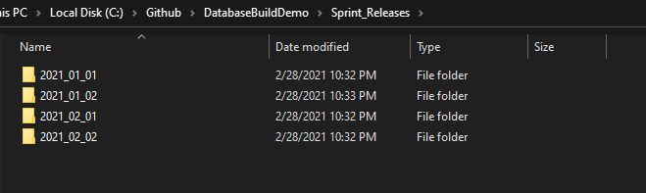
Sprint releases folder structure
Just a bunch of folders for the sprints/release you’re in.
One folder per sprint, and your versioned files and folders will line up in order due to the version naming requirement.
Notes:
Add an image of files in order.

Slide 41
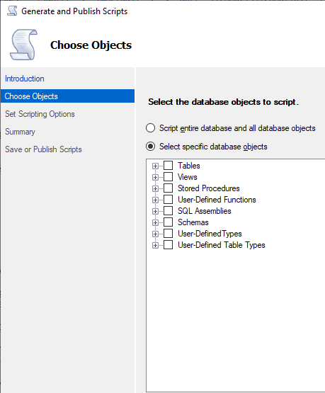
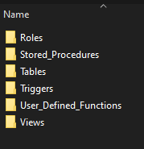
Repeatable folder structure
I like to set up folders like the way the “Generate Scripts” window breaks up objects.
Then I add extra folders for Roles, security, schemas, etc.
You could create folders above or below this folder structure for schemas if you want or keep the schema name in the filename.
Notes:
REDO This slide

Slide 42
When to use repeatable scripts
If the order your change is released in doesn’t matter.
OR
It can go after all current versioned changes.
You can put that change in a repeatable release.

Slide 43
In most cases, use both!
If the order your change is released matters:
Add a versioned release AND update/add a repeatable release script.
This way you can see changes to tables, views, etc. over time and you can control the order the code runs.

Slide 44
Idempotent code
“Insanity is running an idempotent script over and over again and expecting something new to happen.” – Abraham Lincoln, Vampire Hunter.

Slide 45
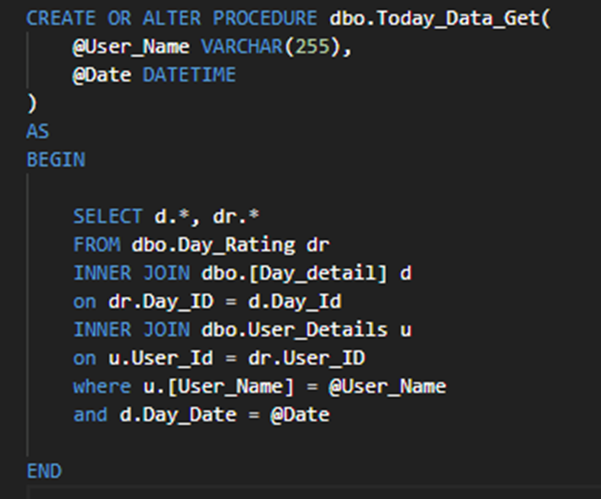
How to make your code idempotent
Use CREATE OR ALTER where you can for:
Views.
Functions.
Stored procedures.

Slide 46
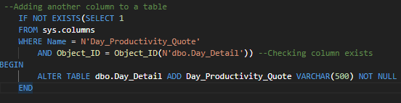
How to make your code idempotent
Where you can’t, use IF EXISTS() and IF NOT EXISTS() to see if the object already exists:
Tables.
Foreign keys.
Data loads.
Notes:
Also try to minimize the amount of dynamic sql you write, unless you are very confident in your dynamic sql skills. The less debugging you have to do on a release night, the better. Boring release code is good release code.

Slide 47
Flyway Commands
Migrate – Main command.
Clean – Drops everything.
Info – Tells you what you’ll be running.
Validate – Validates applied migrations against ones available.
Baseline – Baselines an existing database.
Repair – Repairs the schema history table.
Notes:
Write more under icons, choose better icons for some

Slide 48
Setting up Flyway on Azure DevOps
“Insanity is running an idempotent script over and over again and expecting something new to happen.” – Abraham Lincoln, Vampire Hunter.

Slide 49
What’s a Flyway Docker container?
Allows you to run Flyway through a Docker container on your database.
This way:
You don’t need to install Flyway on build machine.
You don’t need Flyway in your GIT repo.
You can always have the latest version of Flyway ready to go as it’s downloaded as new on EVERY build.
Notes:
Need to say why I like it, and how it’s helpful

Slide 50
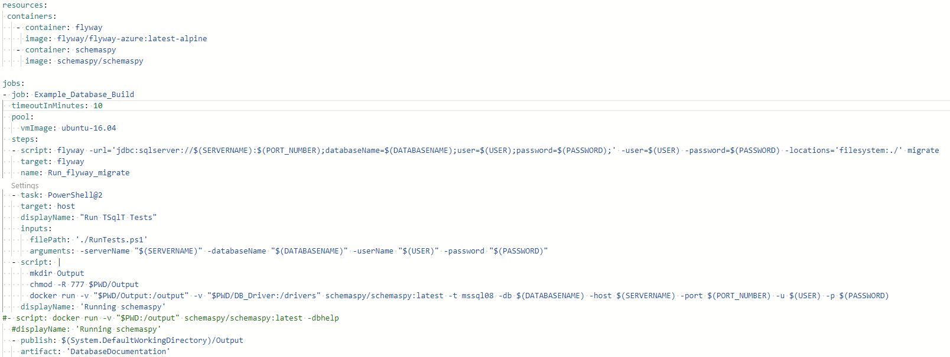
Flyway YAML code
YAML is the latest language Azure DevOps uses for its build pipelines.
Stands for “Yet Another Markup Language”.
You’re basically “marking up” how you want your build to run.
I’ll focus on “Resources” and “Jobs” markup today.

Slide 51
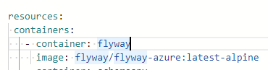
How to create your Flyway container
You can use the Flyway-azure docker container to run Flyway in Azure YAML.
Be sure to use the flyway-azure container.
It needs to use a ‘alpine’ version in order to work.
Notes:
This is the YAML code needed to create your flyway container in Azure DevOps on the cloud.
Be sure to use the flyway-azure container, and it needs to use a ‘alpine’ version in order to work.

Slide 52
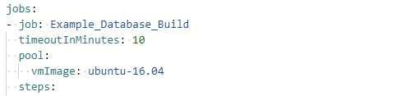
How to set up Your DevOps Job
“Job” is the name of the job you are running.
“timeoutInMinutes” is how long it takes for the job to time out.
“pool” and “vmImage” is the virtual machine or machines. This is using one ubuntu version 16.04 virtual machine.
“steps” is a list of steps to run on the job.
Notes:
Be sure to use the flyway-azure container, and it needs to use a ‘alpine’ version in order to work.

Slide 53
How to run your Flyway container
The first step is running Flyway on the Flyway container. This is done by putting the “flyway” container set up in the previous slide as the “target”.
The “name” – Run_flyway_migrate is the name of the step as it will appear in the job run.
Then the “script” section has the script itself:
url = the jdbc connection string, using the servername, port number, and database name as variables.
user = the username used to log in.
password = the password used to log in.
locations = locations used to pick up the files that need to be run.
migrate = the actual flyway command used.
Notes:
Be sure to use the flyway-azure container, and it needs to use a ‘alpine’ version in order to work.

Slide 54
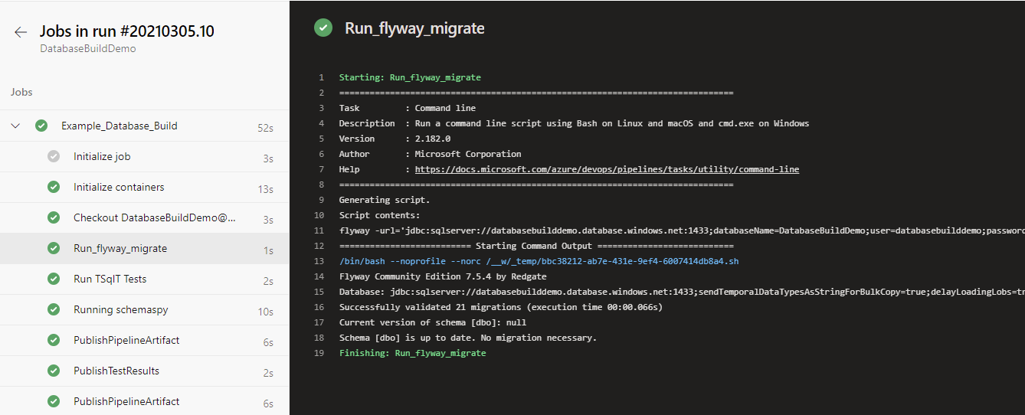
Flyway results

Slide 55
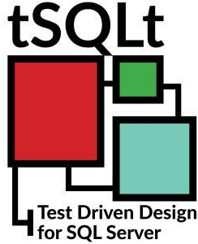
2nd stop – tSQLt setup
We’ll review:
How to run your tests.
PowerShell scripts to run all tests.
YAML code to run the PowerShell and publish the results.
Example results.

Slide 56
The build is done, now time to set up tests
Unit testing is very important, and going into detail would take longer than the time we have left, so I’ll show you how to set up test visibility in your pipelines.

Slide 57
tSQLt setup
Have some test classes and tests in tSQLt.
Use tSQLt.RunAll to run all the tests.
Use tSQLt.XmlResultFormatter to format the results as XML.
Use Powershell to run the SQL code and save the XML for your YAML Pipeline to pick up.

Slide 58
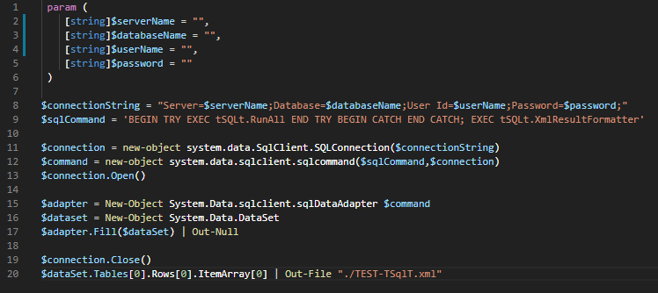
PowerShell code
There’s really only two parts of this that are interesting, the rest is boiler plate PowerShell SQL code.
Notes:
Use new code with server, database and username and password as variables.

Slide 59
PowerShell code
This is the SQL that is being run.
tSQLt.RunAll runs all the tests.
tSQLt.XmlResultFormatter then formats the results into Junit XML to be picked up by Azure DevOps.
Notes:
Use new code with server, database and username and password as variables.

Slide 60
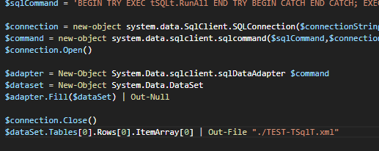
PowerShell code
This is exporting the “TEST-TSqlT.xml” file to be picked up by Azure DevOps in a later step.
Everything else is generating a dataset to be exported into that file.
Remember the “TEST” in the file name, it will be useful later.
Notes:
Use new code with server, database and username and password as variables.

Slide 61
Setting up tSQLt on Azure DevOps
“Just keep making tSQLt.FakeTables, what’s the worst that can happen?” – Albert Einstein, Database Guru.

Slide 62
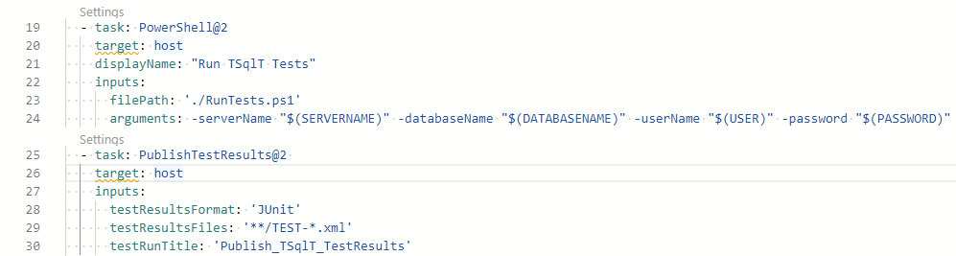
YAML code
This section runs the PowerShell script reviewed previously.
Make sure the “target” is “host” to run this on the Ubuntu16.04 VM.
Arguments are just arguments set by the script, being passed in.
Notes:
Use new code with server, database and username and password as variables.

Slide 63
YAML code
This section shows the test results.
Ensure you have Junit as the test results format.
Set your testResultFiles format to be the same as the test file you created in your PowerShell script.
Notes:
Use new code with server, database and username and password as variables.

Slide 64
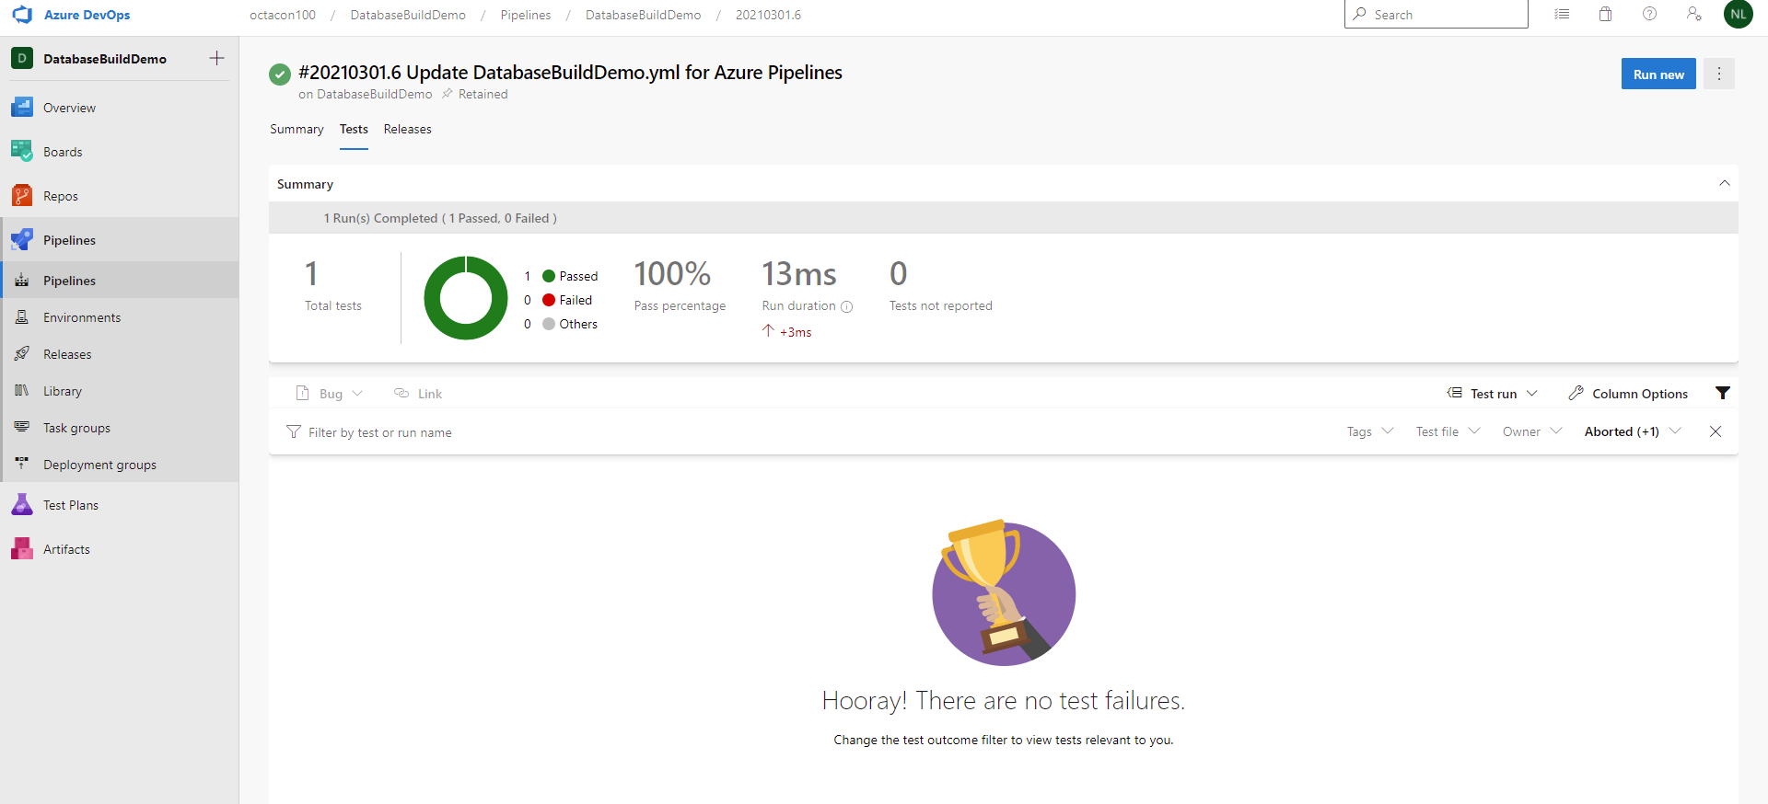
Testing results

Slide 65

3rd stop – SchemaSpy setup
We’ll review
SchemaSpy Documentation.
Using YAML, Docker and SchemaSpy to generate documentation artifacts to be published.
YAML code to run the PowerShell and publish the results.
Example results.

Slide 66
SchemaSpy documentation
SchemaSpy generates documentation in a few sections:
Tables and Views.
Columns.
Constraints.
Relationships.
Orphan Tables.
Anomalies.
Routines.

Slide 67
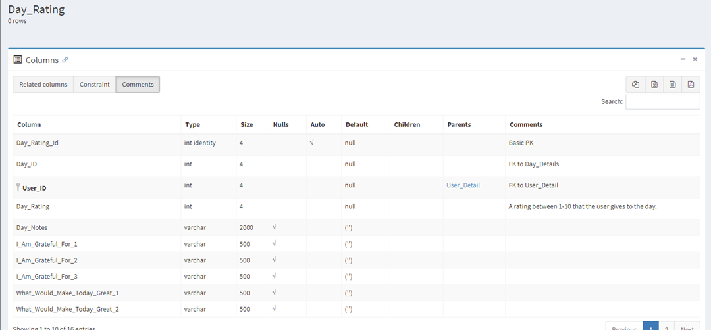
Example SchemaSpy documentation

Slide 68
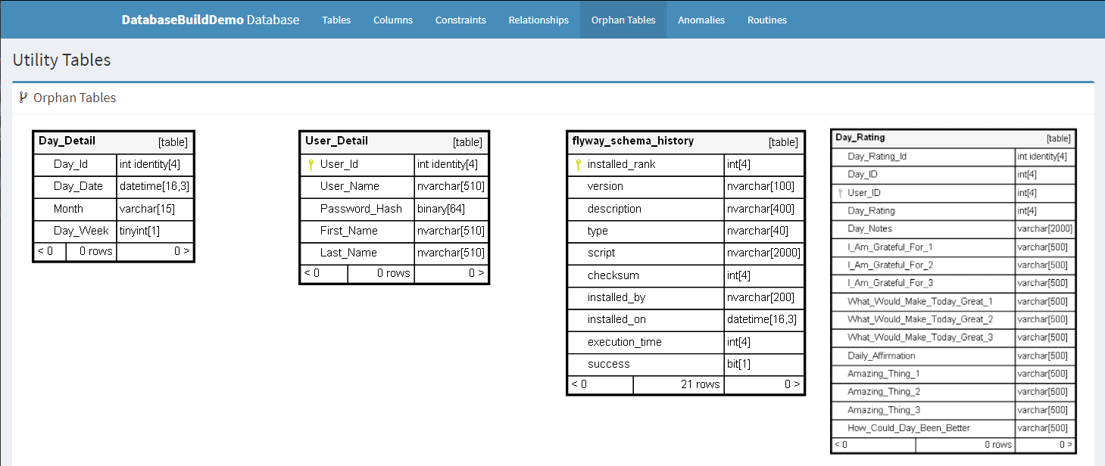
SchemaSpy docs
Orphan Tables:
SchemaSpy provides diagrams of all your orphan tables.

Slide 69
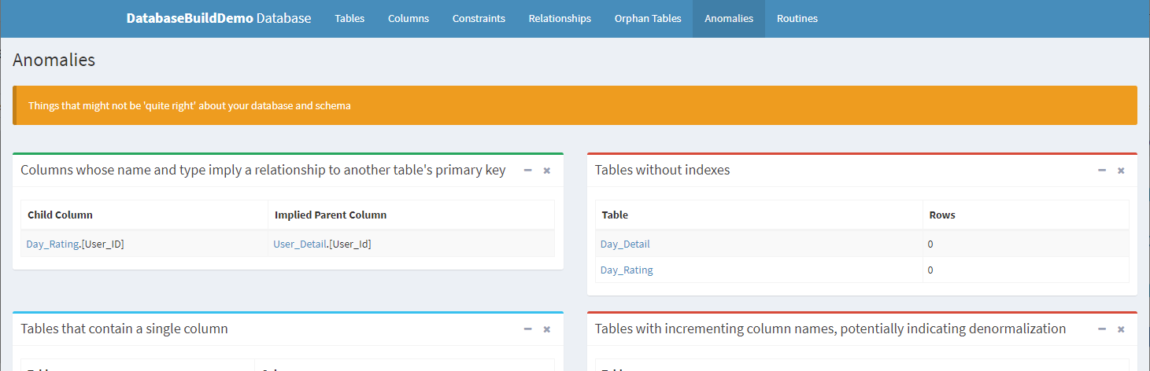
SchemaSpy docs
Anomalies:
SchemaSpy provides areas of interest you might want to investigate or fix.

Slide 70
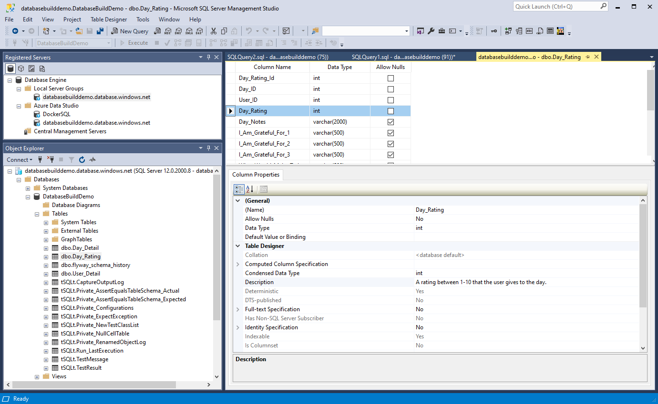

How to get text into Schema Spy
Use the “Description” extended property on your column.

Slide 71
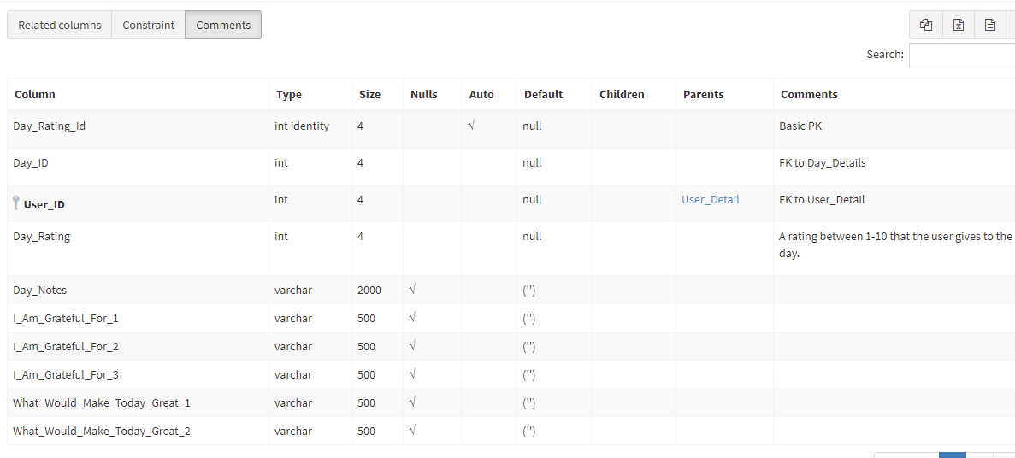

How to get text into Schema Spy
This will then appear in your documentation.

Slide 72
Setting up SchemaSpy on Azure DevOps
“Multiline script commands are confusing.” – Nikola Tesla, DevOps Genius.

Slide 73
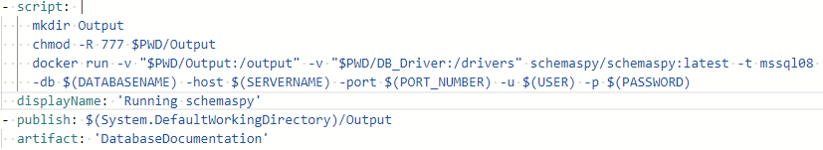
How to run SchemaSpy in Docker with YAML
This section is a multi-line Linux script to:
Create a “Output” folder
Give the process write access to the “Output” folder.
Run SchemaSpy.
When running SchemaSpy, you need to set up the external mounts with the –v flag.
Notes:
Be sure to use the flyway-azure container, and it needs to use a ‘alpine’ version in order to work.

Slide 74
How to run SchemaSpy in Docker with YAML
Then you need to use the following settings to get SchemaSpy to run:
You need to mention the docker image you want to use.
-t: The driver to use to connect. (Need the driver in driver folder.)
-db: The database name.
-host: The server name.
-port: The port to connect to.
-u: The username to log in with.
-p: The password to log in with.
Notes:
Be sure to use the flyway-azure container, and it needs to use a ‘alpine’ version in order to work.

Slide 75
How to publish artifacts using YAML
To publish artifacts from AzureDevOps, create a “publish” task and write in the folder you want to publish.
Then give it an artifact name.
You’ll then see those artifacts when Azure DevOps finishes the build.
Notes:
Be sure to use the flyway-azure container, and it needs to use a ‘alpine’ version in order to work.

Slide 76
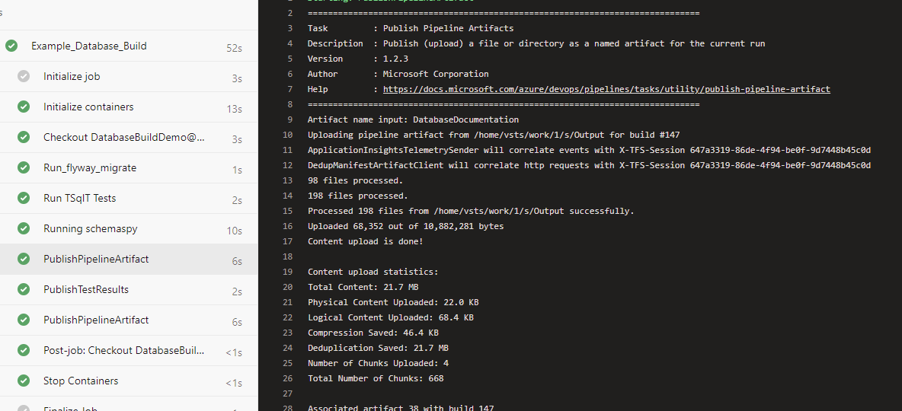
Publish results

Slide 77
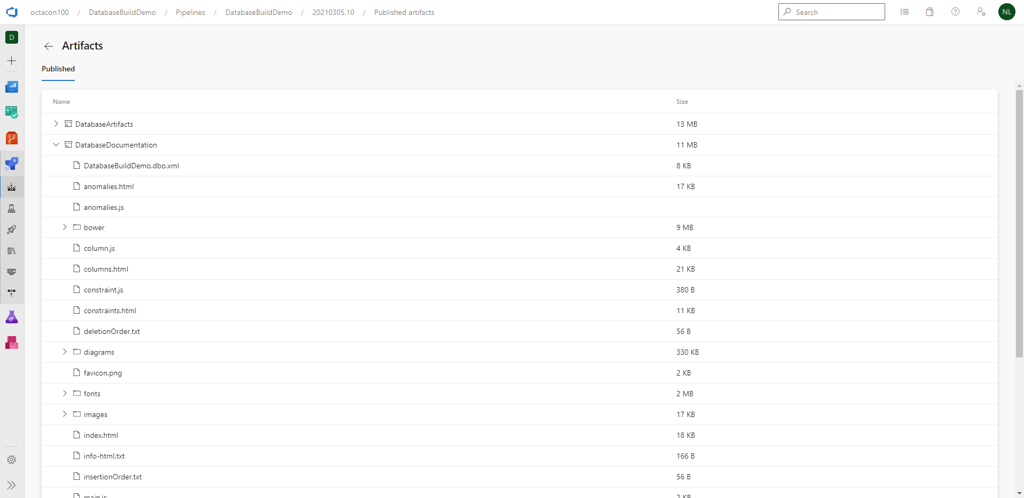
Artifact Results

Slide 78
So now I know what you’re talking about, what now?
I’m going to review the demo again and see if I can answer some of your questions this time around.
It’s demo time again!
Notes:
I like to begin with the end in mind, so I’ll show you what you end up with, why it’s cool, and then the steps you’ll want to follow to get your database in that state.
(Demo)

Slide 79
Thank you
Thanks for your time.
In this talk, you’ve been given a quick introduction to:
Flyway.
SchemaSpy.
tSQLt.
Azure Devops and YAML.
I have a Github up at: https://github.com/Octacon100/GitHubDatabaseBuildDemo if you want to review the code.
It will be on the New Stars of Data Github as well.

Slide 80

Questions?

Slide 81

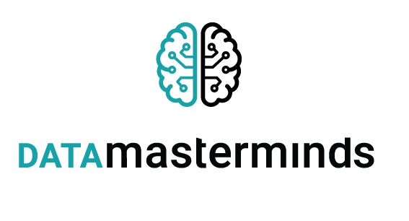

Final Thank You
Thanks to everyone working on “New Stars of Data” for all their help.
Thanks to our sponsors.
My Details:
Twitter: @Octacon100
Github: http://github.com/Octacon100
Website: https://octacon100.github.io/

